Slide 1
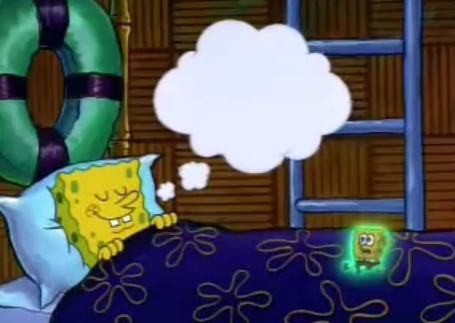
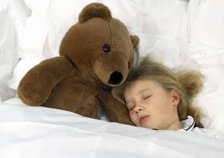
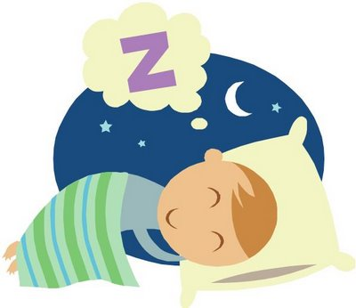
Why Do We Get Dreams?
By Roshni Patel and Shriya Patel

Slide 2
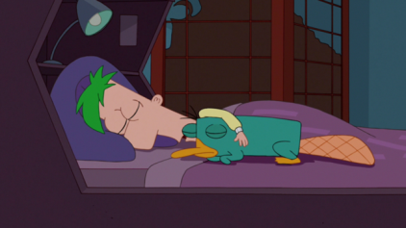
What is a Dream?
A dream is a particular state of mind in which it can be experienced by anyone.
Dreaming is another whole world in which it uses our unconscious mind.
A dream is also a story from the past event or an indication of the future
This is sometimes why we get a “déjà vu” kind of situation.

Slide 3
What is Déjà Vu?
A feeling of having already experienced the present situation.
Déjà vu has to do with the conscious mind where as a dream has to do with the unconscious mind.
Déjà vu can be experienced by any and all the senses we have.

Slide 4
What is a Nightmare?
It is a very horror dream that can cause a strong emotional response from the mind.
Nightmares become so intense that people believe they are interacting with evil from outside themselves.
Nightmares are usually caused by some kind of stress in your life.
Nightmare are also caused by a severe intake of very heavy drugs and hanging out with bad people that might try to hurt you
Nightmares sometimes an indication of what might happen to you and what has happened to you

Slide 5
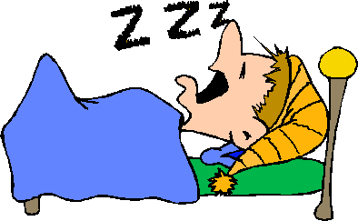
Lesson For nightmares and dreams
If you think about something bad before you sleep or you have though about something bad in the past than you are sure to get a nightmare if you think about God or something pleasant than you will have a dream of something non terrifying.

Slide 6
The Psychological reason for Dreams.
Psychologists say that we get dreams when we are in the REM(Rapid Eye Movement), which states that even though our eyes may seem closed they are moving under our eyelids.
During the process of REM, the brain is also active because that is where our dreams are being processed.
They also say that we have innumerable vessels near the brain that form one thick band. Many conscious, subconcious and invisible pictures are stored in this band. In a course of time these pictures get transformed into dreams

Slide 7
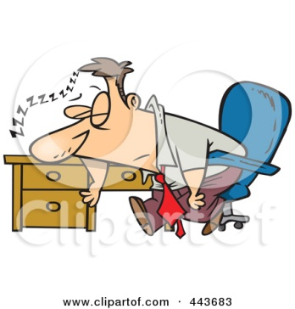
Psychological reasons for Dreams Continued…
They believe that dreams have a meaning and a purpose and cannot be merely considered as a chemical reaction.
Some Psychologists say that dreams symbolize our suppressed desires and represent our subconscious emotions, thoughts and desires.
In addition Psychologists say that dreams influence the mental makeup of a person

Slide 8
Classification of Dreams.
Dreams are classified into three categories:
Dreams that are influenced by bodily conditions
Dreams that are reactions to mental conditions.
Spiritual dreams which reflect our past and our future conditions. Spiritual dreams also state that a man’s life is influenced by the sleeping state rather than the waking state.

Slide 9
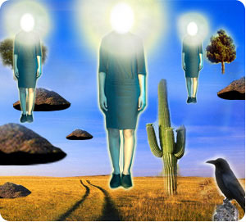
Quote on Dreams.
“What dreaming does is give us the fluidity to enter into other words by destroying our sense of knowing this world…Dreaming is a journey of unthinkable dimensions, a journey that, after making us perceive everything we can humanly perceive,… - Carlos Castaneda
This is one of Castaneda's paintings that inspired him to say this quote.

Slide 10
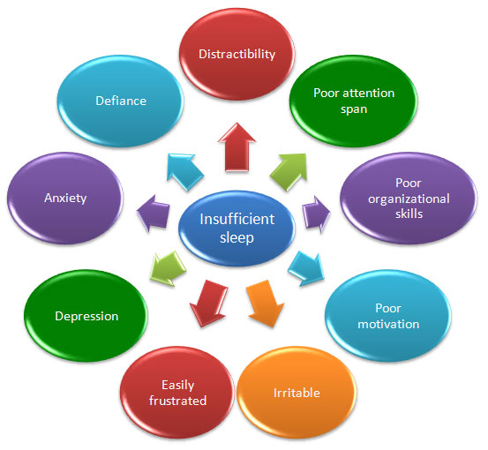
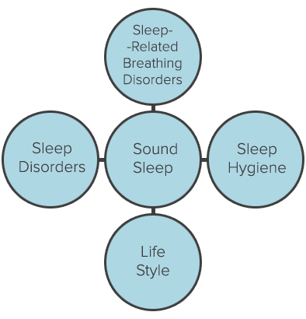
Sleeping Disorder

Slide 11
What is associated with lack of sleep?
There are two major conditions associated with the lack of sleep.
The first is insomnia which is when a person is not able to sleep, he or she spends the night twisting and turning in bed to try to go to sleep. The symptoms are lack of energy, tiredness and laziness.
The second is obstructive sleep apnea which is when a person is able to sleep but snores during sleep and has interrupted sleeping patterns and this leads to inflamed tonsils, inflammation of nasal sinus and sleep apnea.

Slide 12
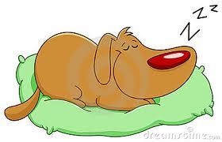
Worldwide Surveys
One problem discovered was that people don’t think about a long term solution for the sleeping disorders and start taking sleeping pills.
Sleeping pills are sedative hypnotics and are habit forming that are addicting.
Slowly individuals become completely dependent on these pills for getting sleep.
Symptoms for these pills include: burning or tingling in hands, arms, legs, or feet, changes in appetite, dry mouth or throat, drowsiness and parasomnia.

Slide 13
The Institute of Human Behavior
According to researchers consumption of sleeping pills over a long period of time may induce in long lasting mental health problems.
A person who gets good sleep wakes up energetically and approaches the day feeling refreshed.
A person who do not get enough sleep lives a disorganized life style which leads to habitual alcoholic consumptions and unhealthy diets.

Slide 14
N.R.E.M and R.E.M
N.R.E.M is non-rapid eye movement. It is a reoccurring sleep state in which dreams do not occur.
R.E.M is rapid eye movement, which states that even though our eyes may seem closed they are moving under our eyelids.
These are the 2 basic phases in a normal nights sleep.

Slide 15
Four Stages of N.R.E.M Sleep
The first stage is the reduction of brain activity from wakefulness state which lasts 5-10 minutes.
The second stage is a period of light sleep during which the heart rate slows down and the body temperature decreases, at this point the body prepares to enter deep sleep.
The third and fourth stages are deep sleep stages where a person experiences dream and during the deep sleep stage the body regenerates tissues, builds bones and improves, immune system.

Slide 16
Curing sleeping disorders
One way to cure sleeping disorders is to practice Mantra chanting which recognizes the powerful calming effect.
Another way is to read inspirational books before sleeping to increase the positivity in our minds
Lastly by eating a healthy plant-based diet and drinking recommended amount of water keeps the mind and body healthy to provide for a comfortable and rejuvenated sleep.

Slide 17
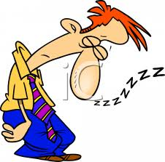
THE END

